Slide 1
Grant Writing Essentials
Robin witty
Team member

Slide 2
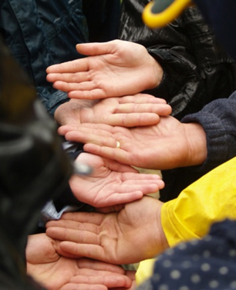
Sport Law & Strategy Group
Providing strategic insight to the Canadian sport community through professional services in these areas:
Legal Solutions
Communications & Marketing
Leadership Development, Human Resource Management and Integral Coaching®
Governance, Compliance, Risk Management, and Financial Management
Strategic Planning, Research, and Member Surveys

Slide 3
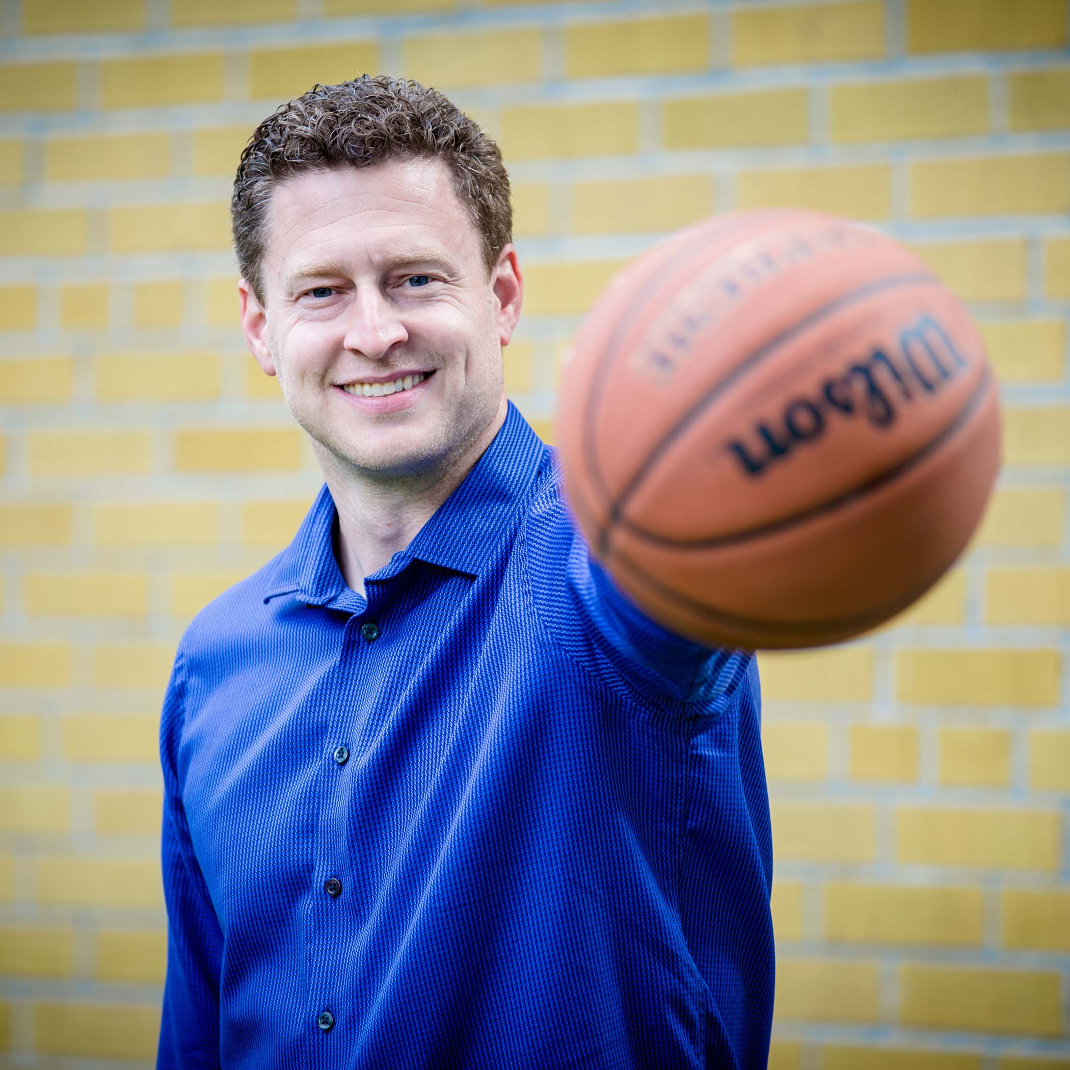
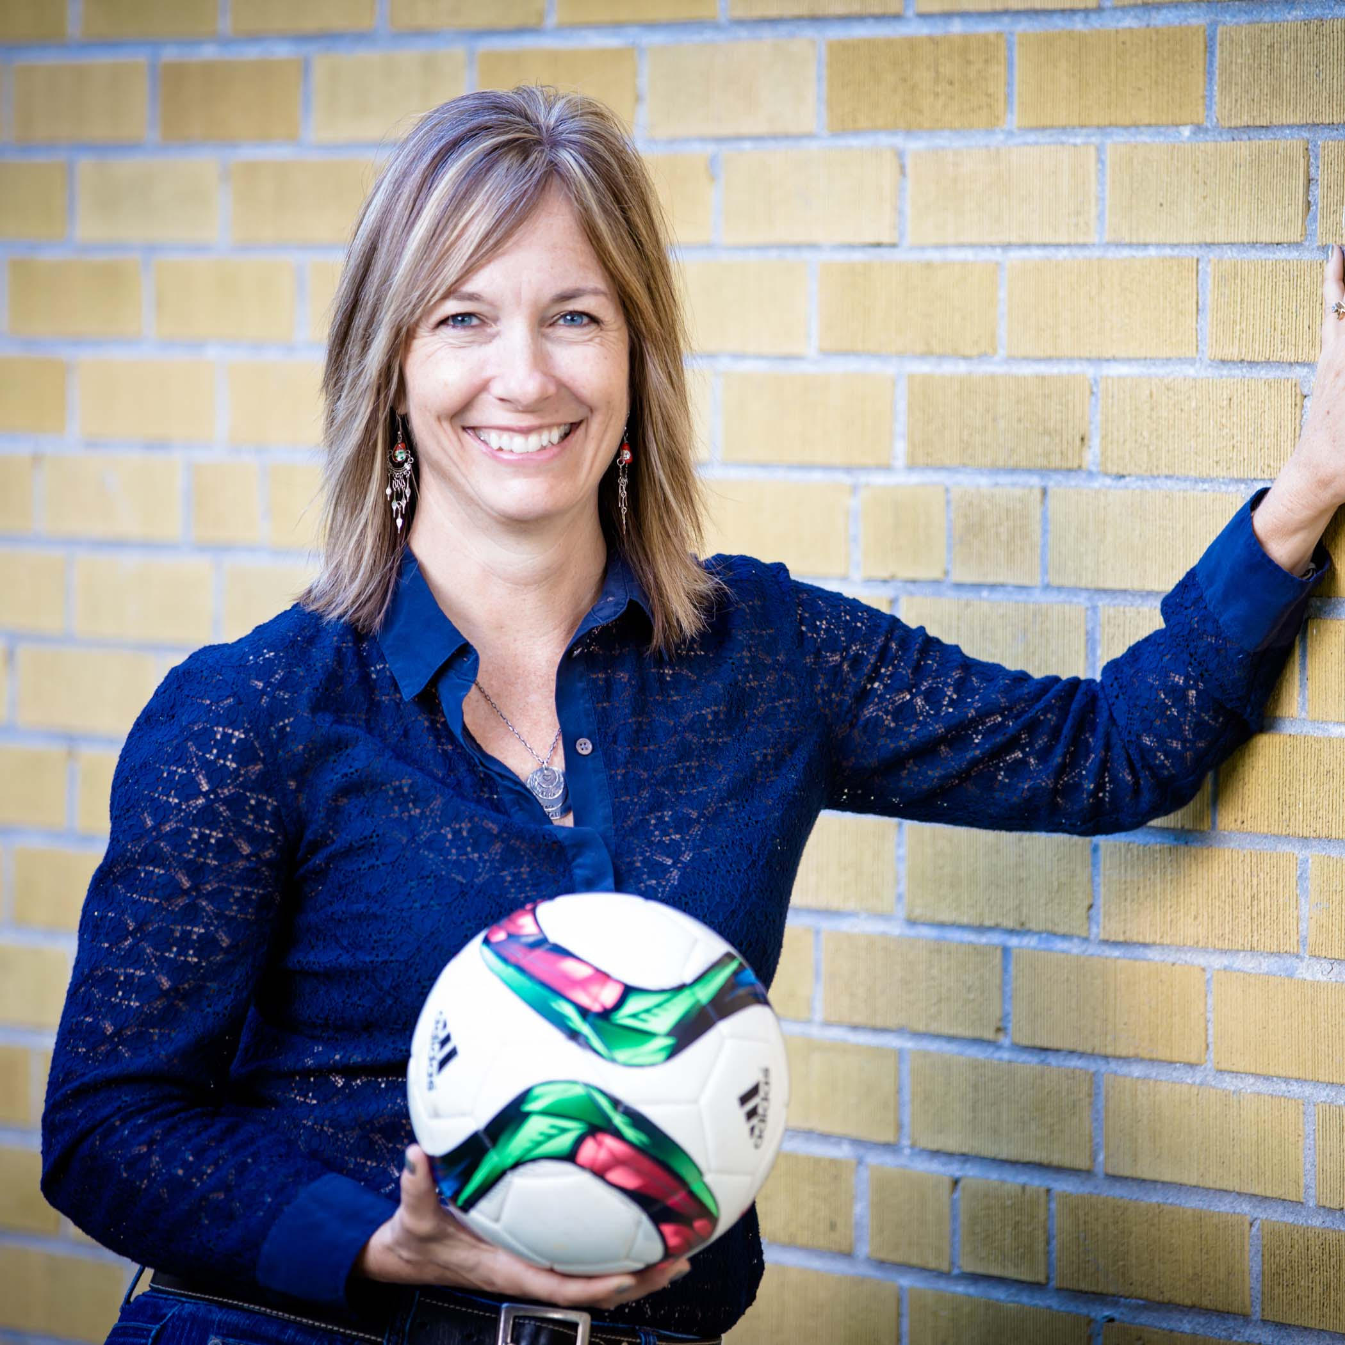
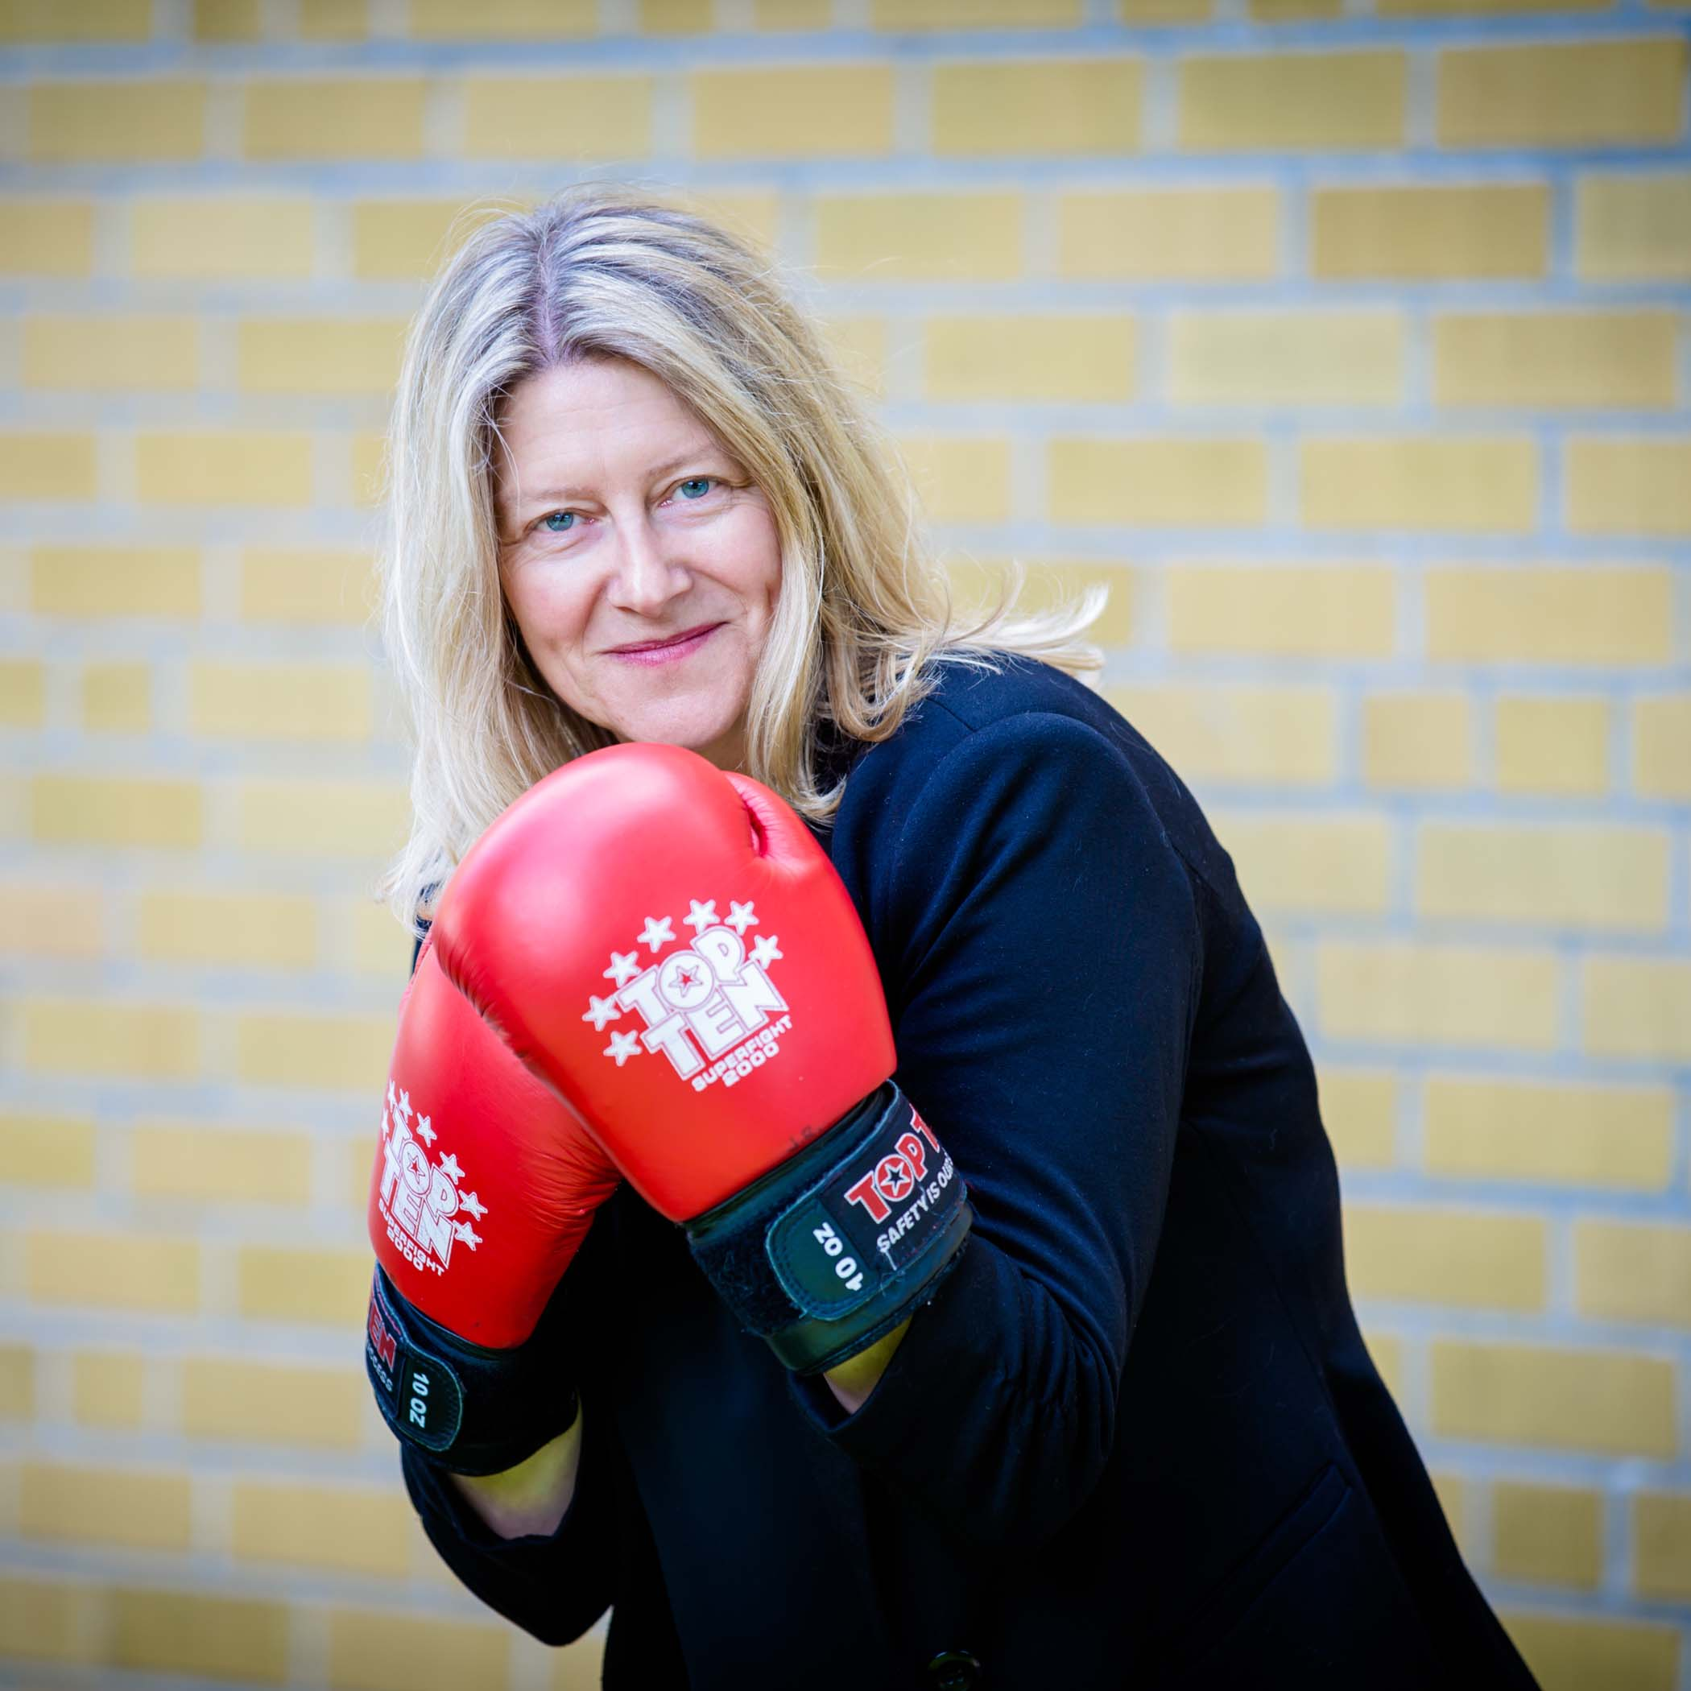
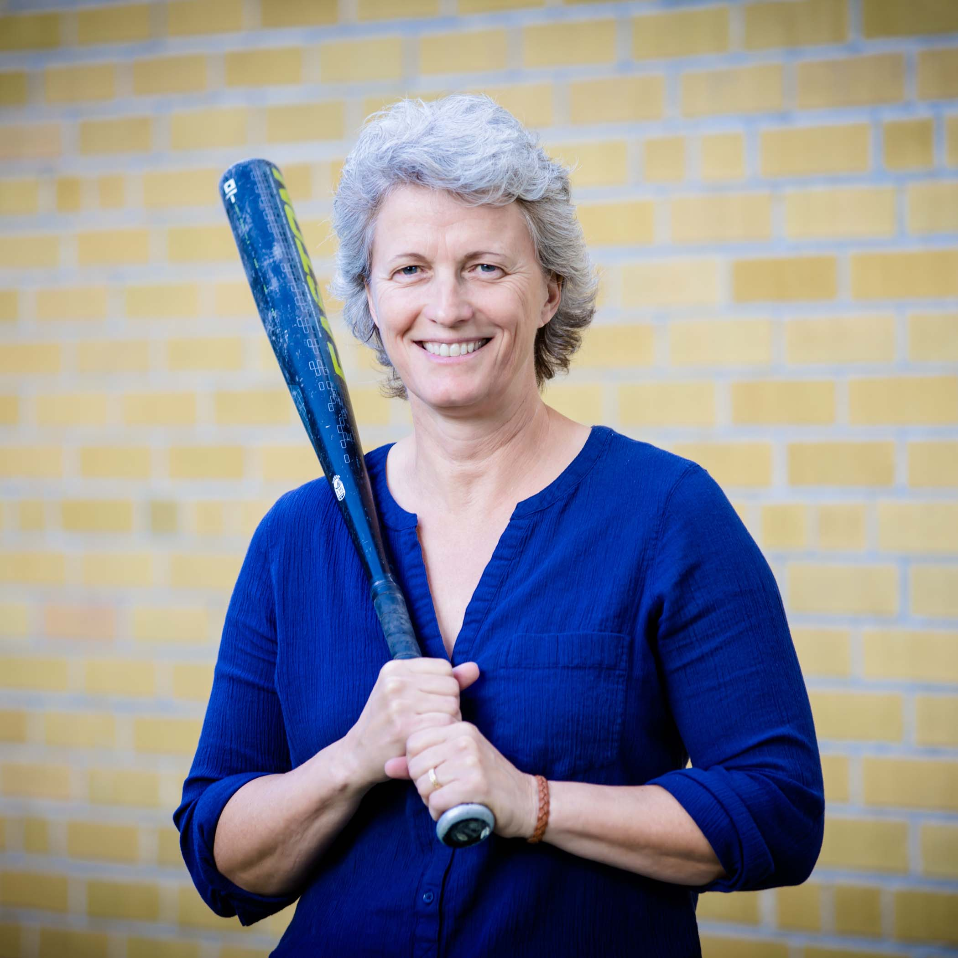
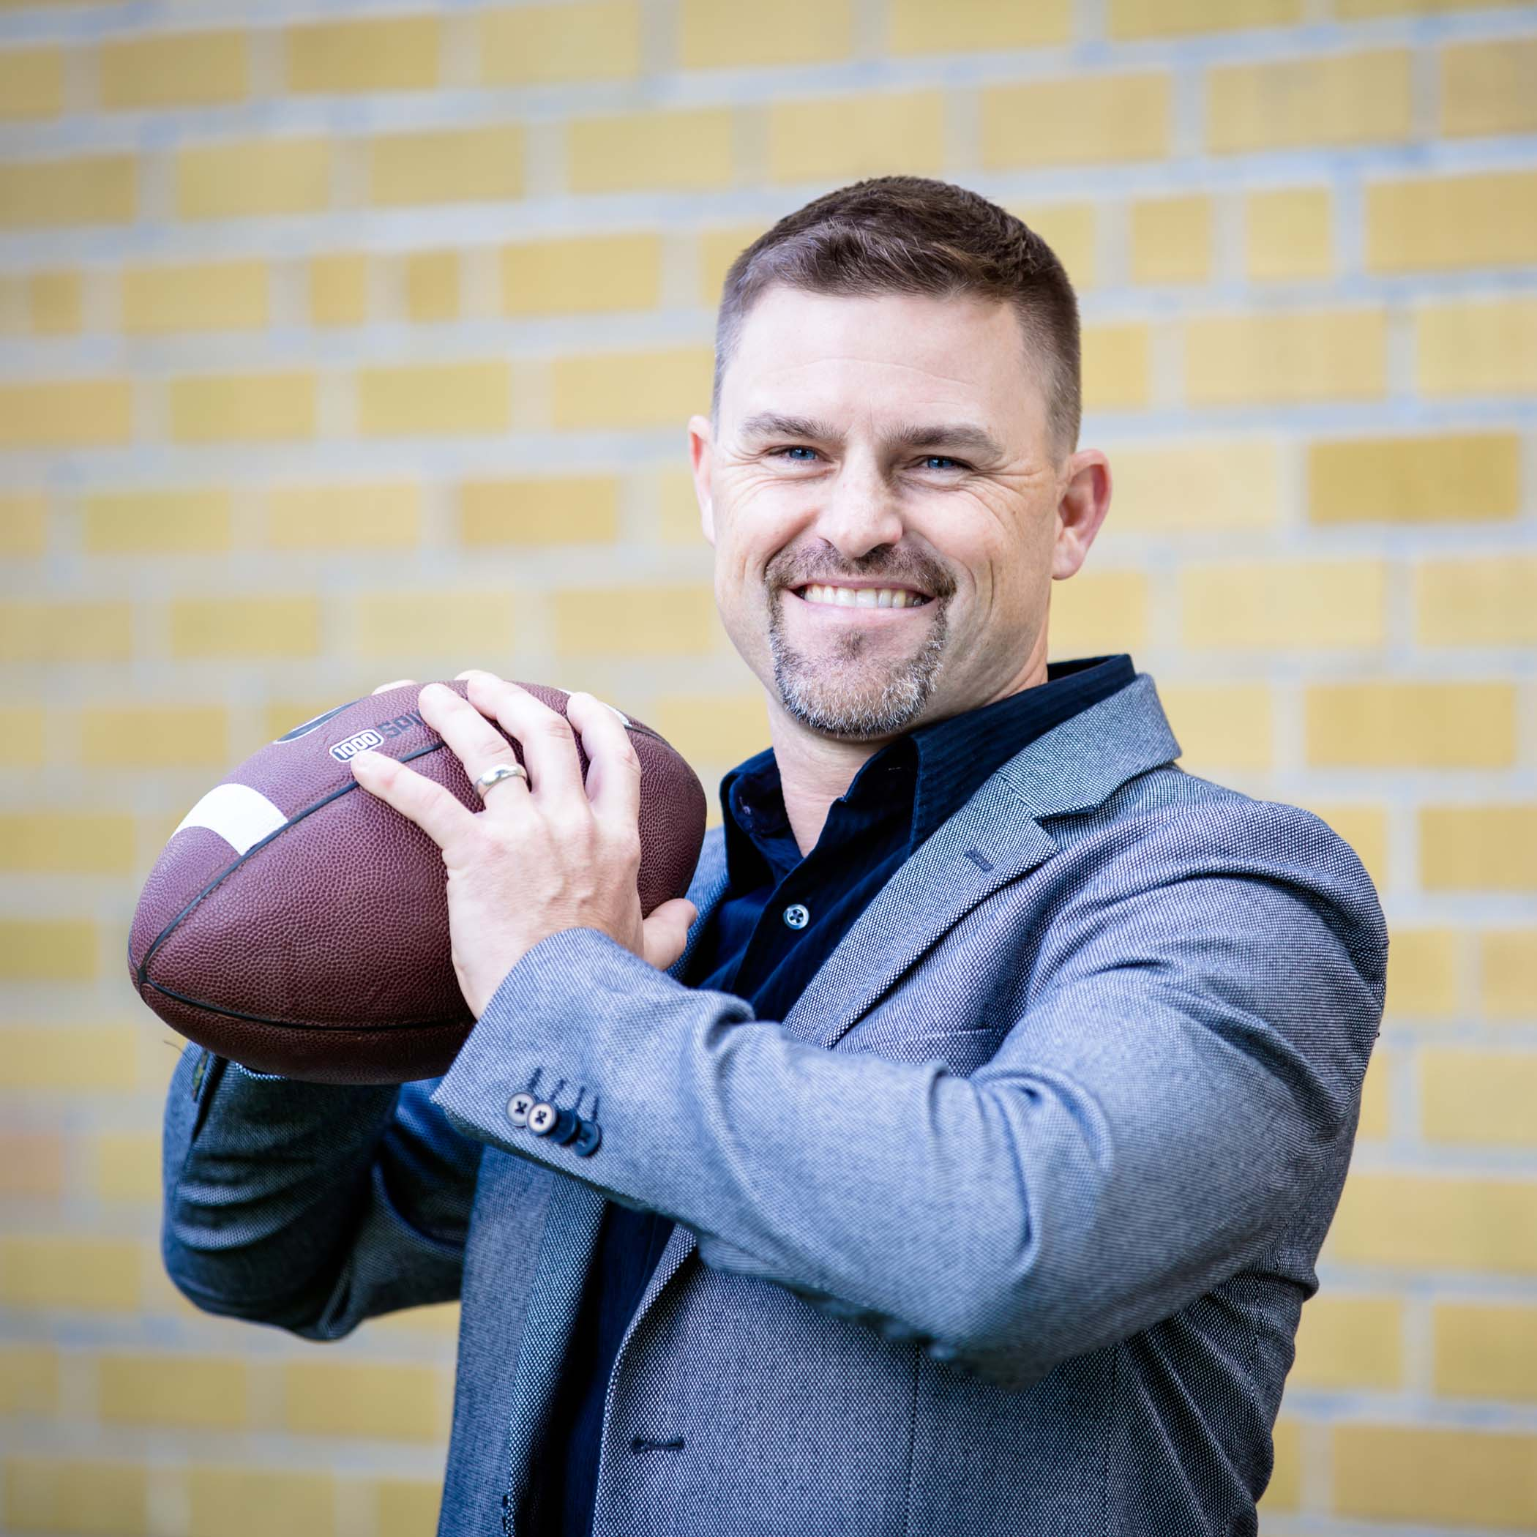
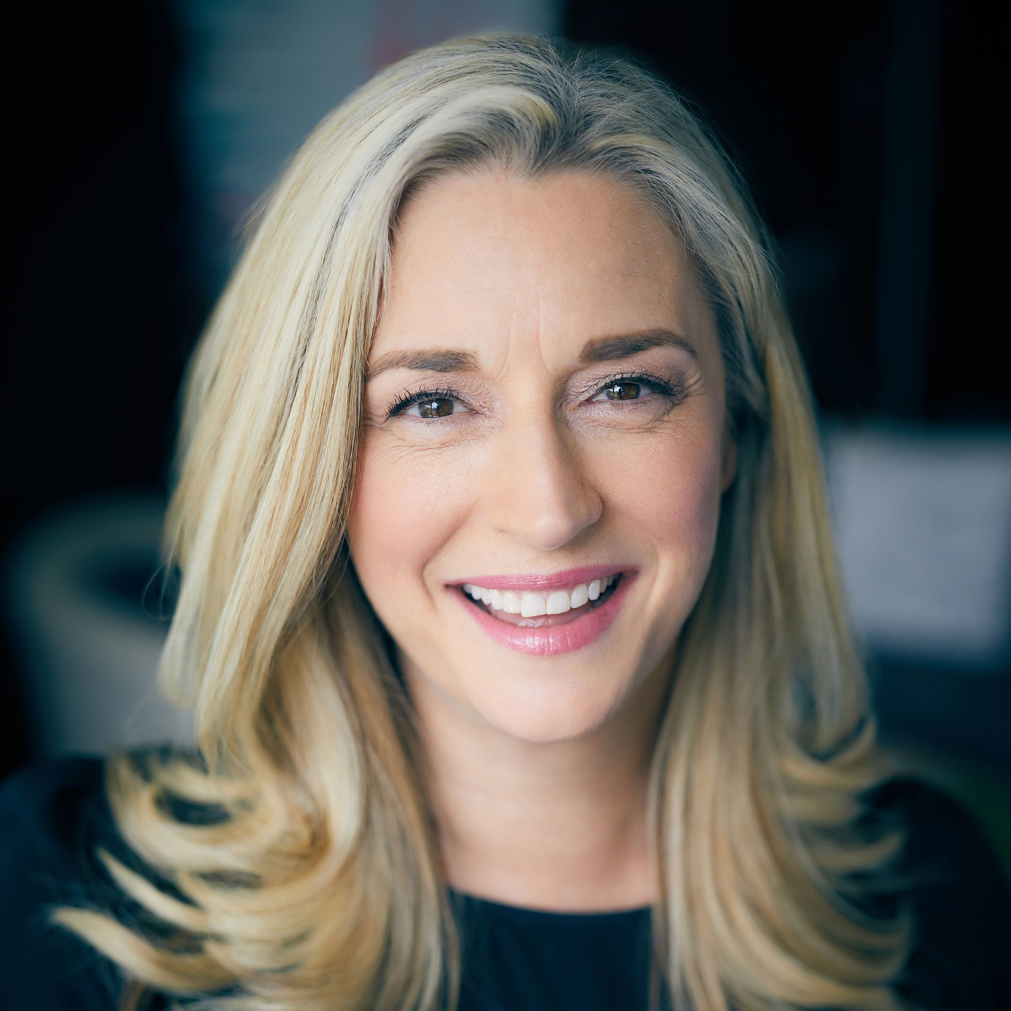
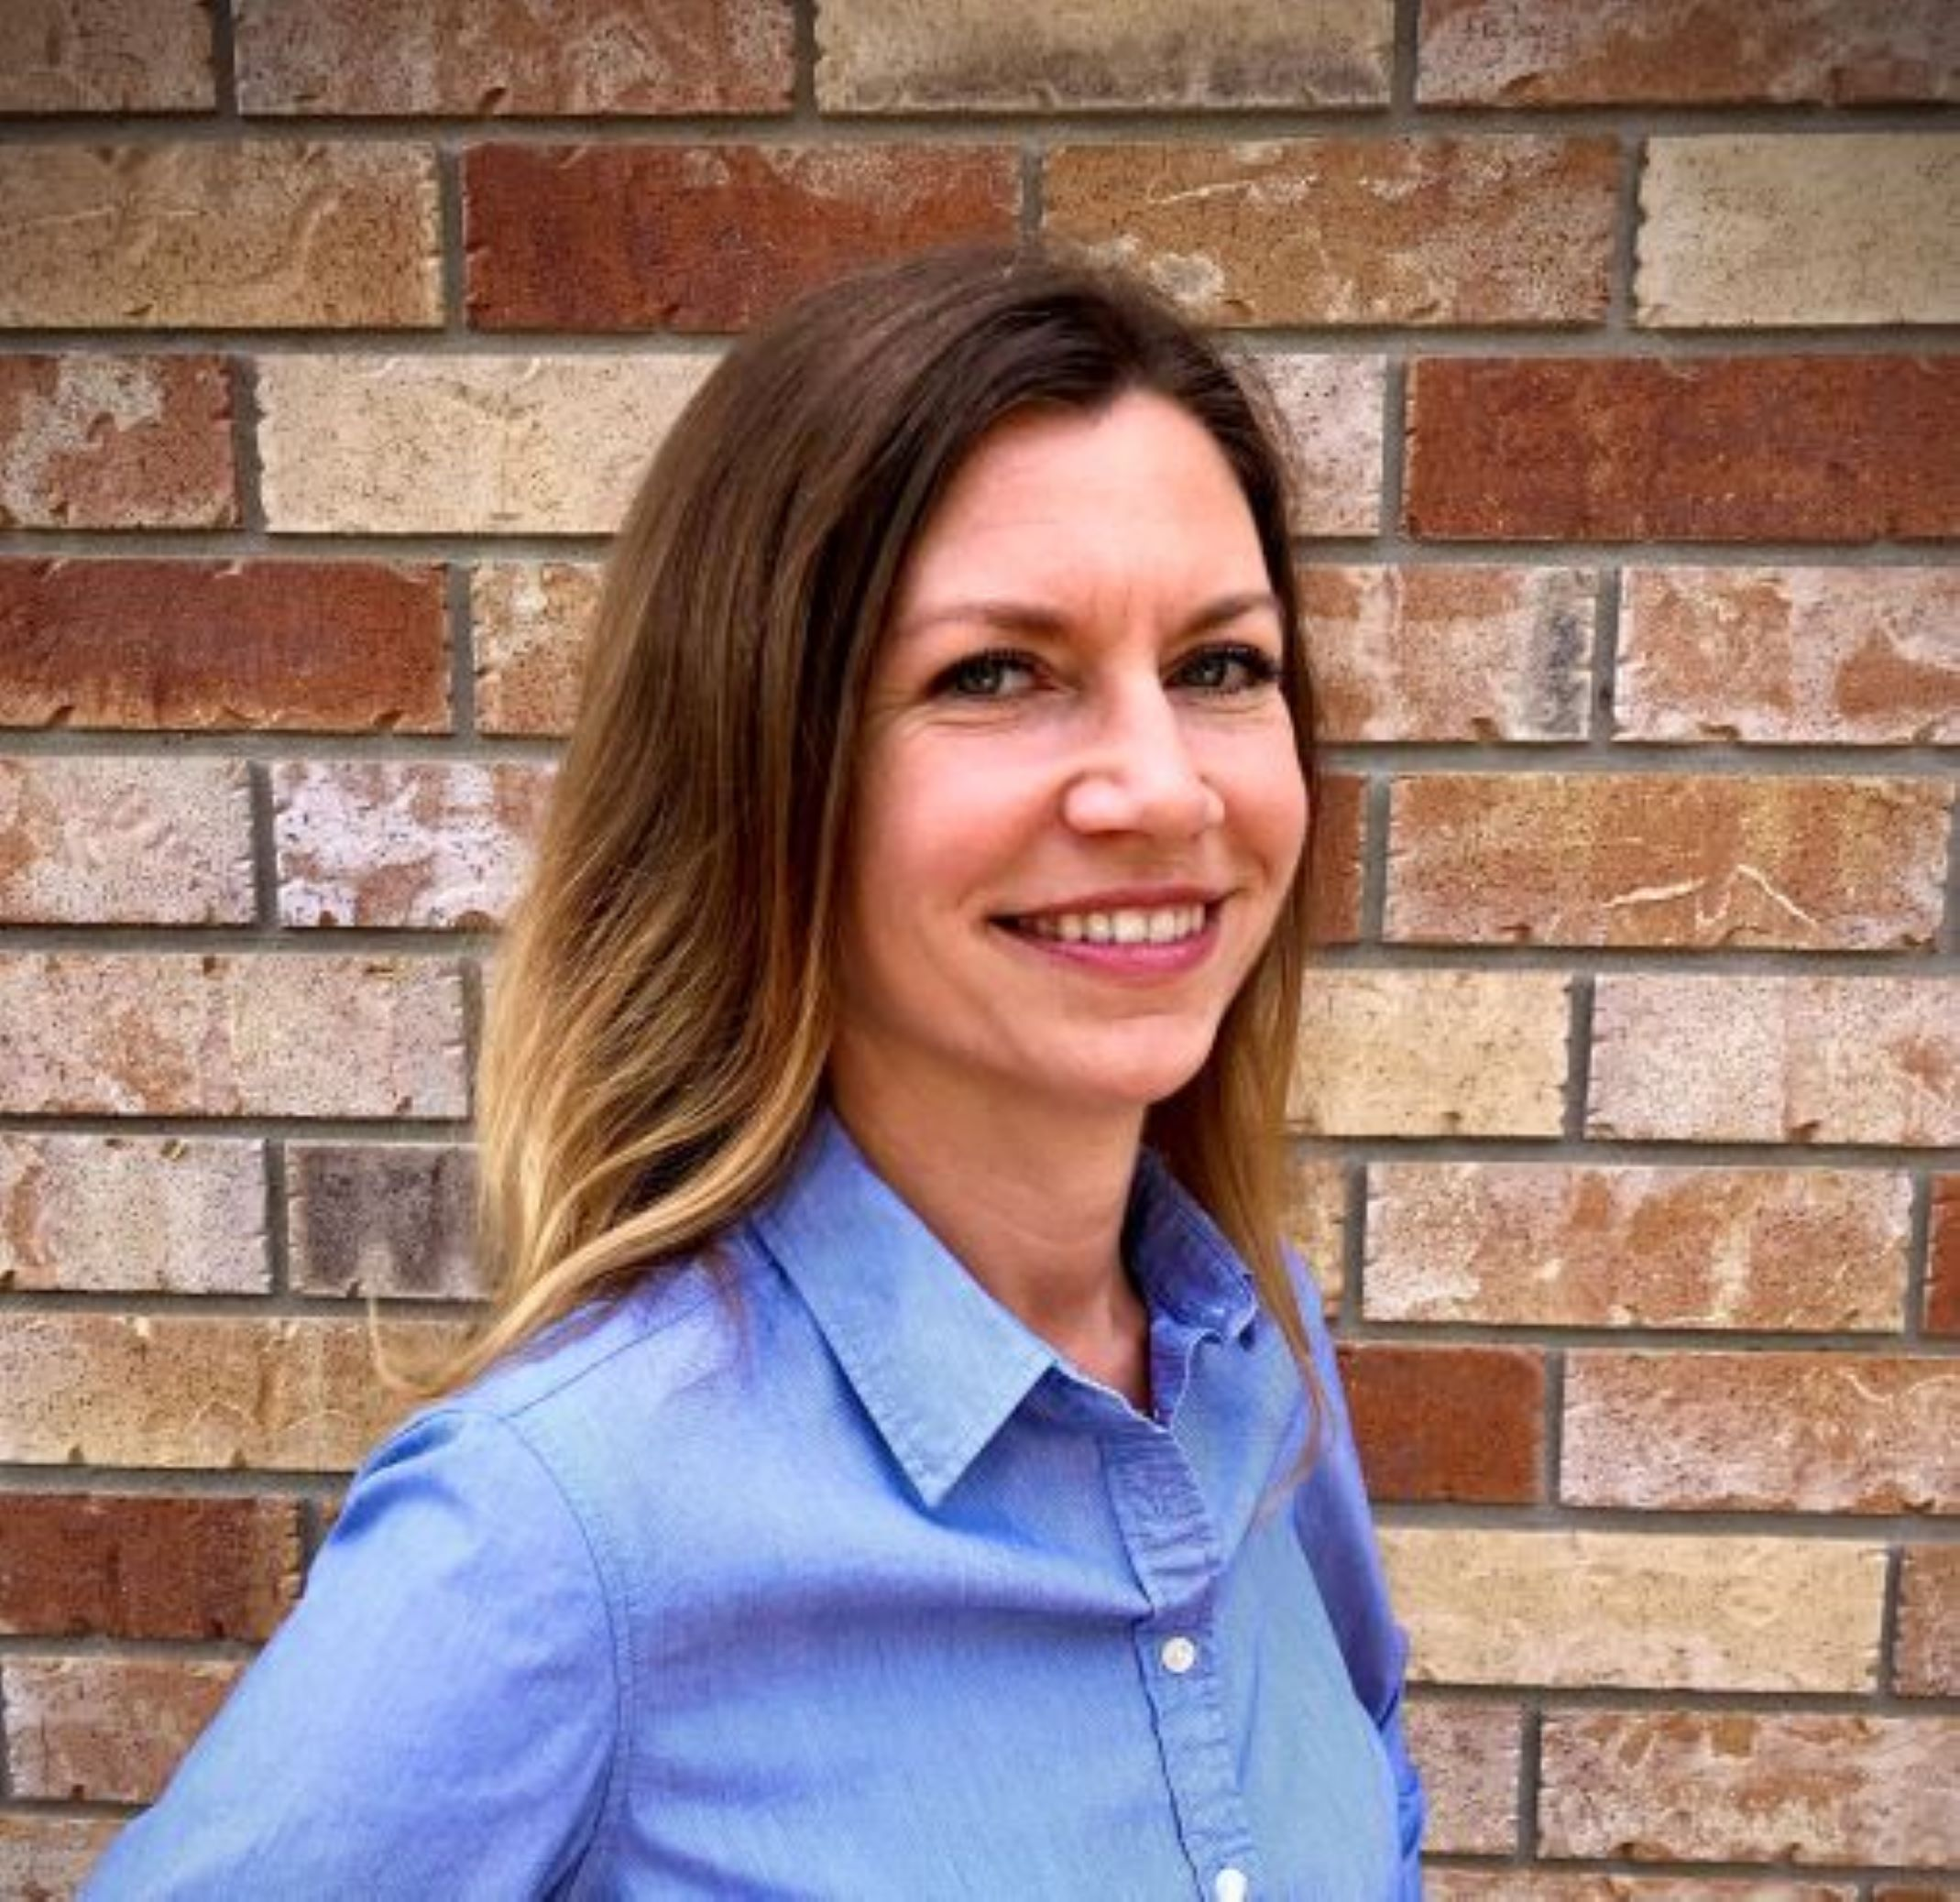
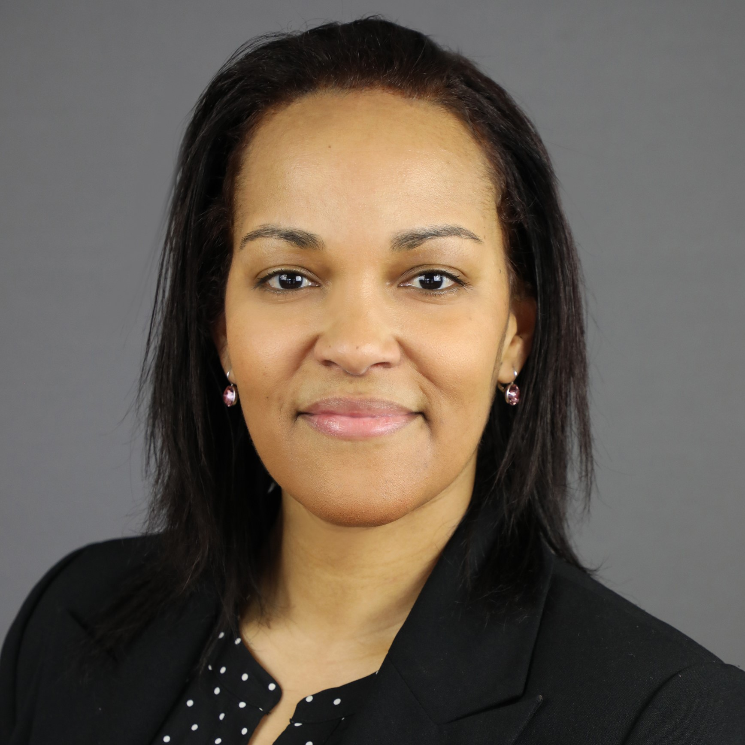
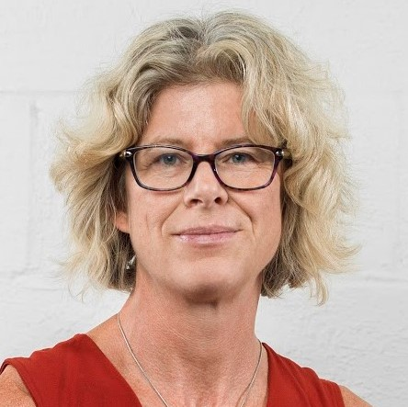
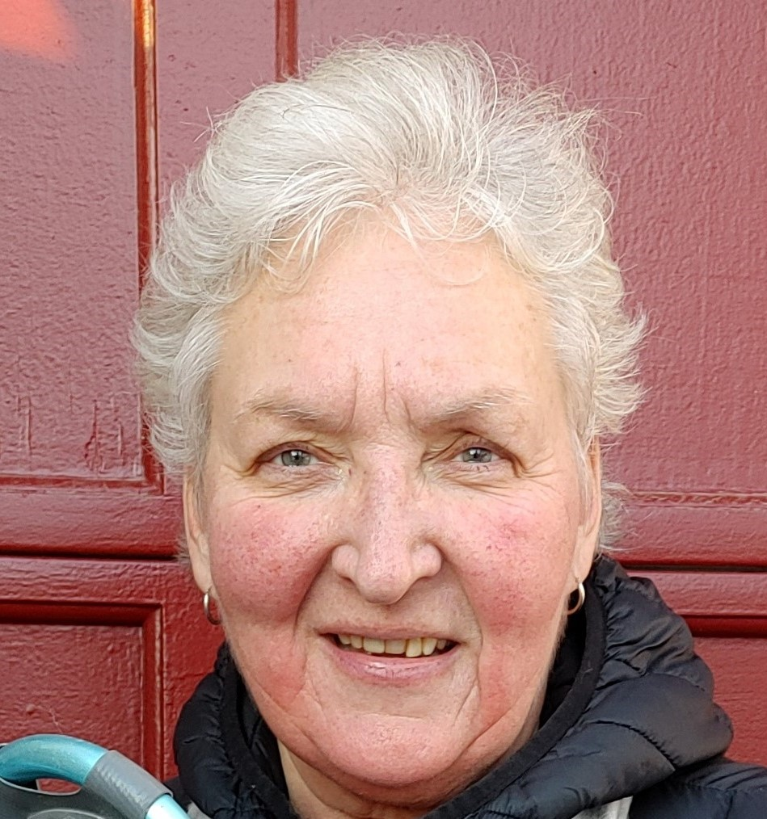
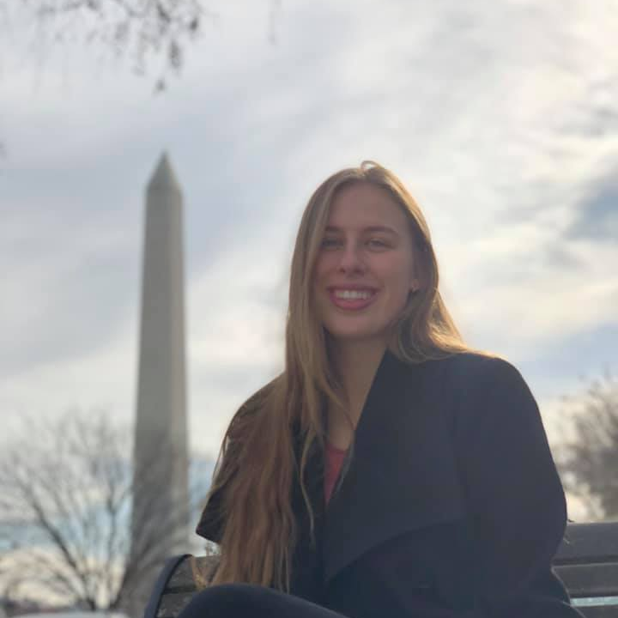
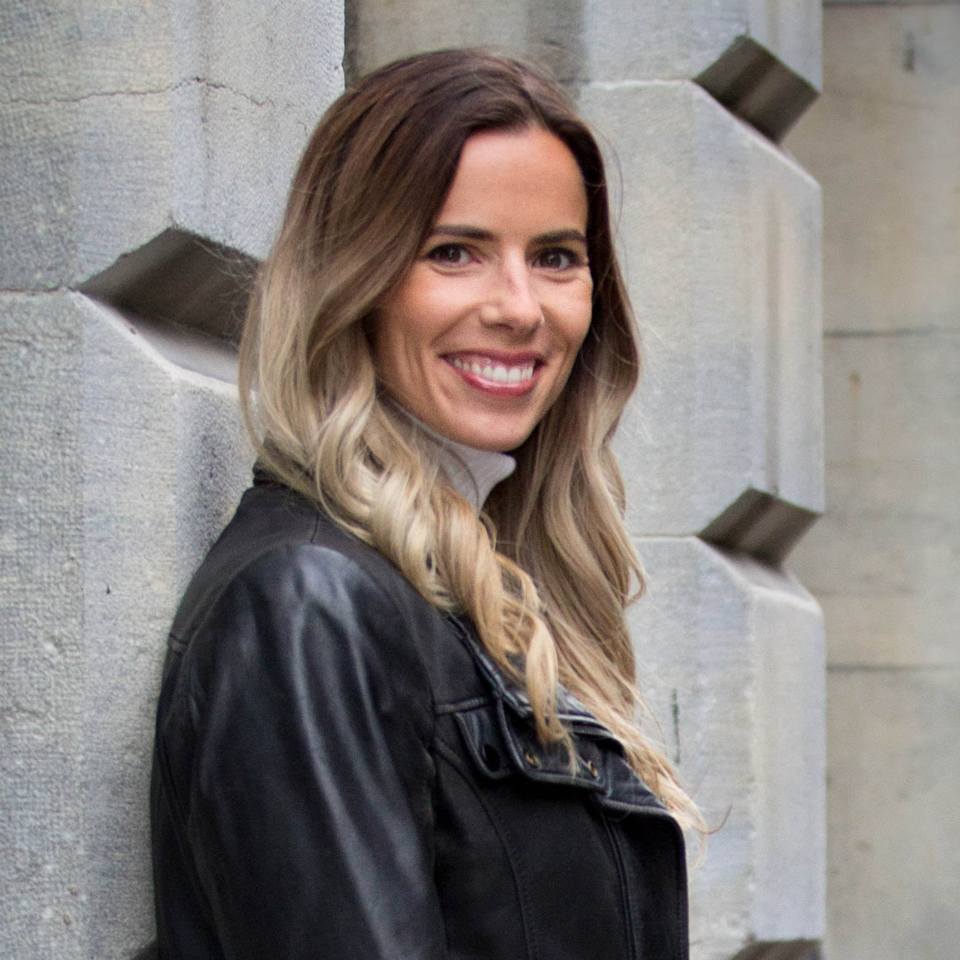
Our Values + Our Team
We strive for excellence in all that we do and aim to provide exceptional value to our clients. We embrace the following values:
Professional Integrity:
We act fairly, ethically and compassionately.
We are reasonable and accessible.
We are a trusted partner.
Continuous Learning
We educate ourselves and our clients.
We ask questions, challenge conventional thinking and push boundaries.
We are driven to find simple solutions to complex problems.
Shared Passion
We care about our clients and the achievement of their goals.

Slide 4
Agenda
Grant Writing Cycle
The Proposal
Do’s and Don’ts
Comparison of grant writing to interviewing
Resources
Feedback survey
Q & A’s

Slide 5
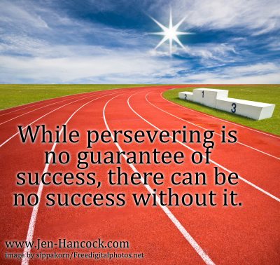
Addressing challenges
This is your story
Start small
Use a team
Don’t give up
This Photo by Unknown Author is licensed under CC BY-NC-ND

Slide 6
The Process

Slide 7
What is a Grant?
”A grant is a bounty, contribution, gift, or subsidy (in cash or kind) bestowed by a government or other organization (called the grantor) for specified purposes to an eligible recipient (called the grantee).
Grants are usually conditional upon certain qualifications as to the use, maintenance of specified standards, or a proportional contribution by the grantee or other grantor(s).”1
1 - Business Dictionary

Slide 8
What is a Grant?
“Grants are typically awarded to nonprofit organizations for a distinct program or purpose. Grantmakers generally focus their “giving” on:
A specific population (such as girls age 11-14 as well see in one grant)
Certain types of nonprofits (such as sport organizations or environmental groups)
Particular types of support (such as program development or funding for equipment)”1
1 - https://donorbox.org/nonprofit-blog/grant-proposals/

Slide 9
What types of grants are available?
Operating support or unrestricted funding is a grant for day-to-day operating costs. It is used to support the general work of an organization and is not dedicated to a particular purpose or project. (these are usually your bigger funder, prov/feds)
Capital support is most commonly given for specific capital campaigns. These involve building construction or acquisition, land acquisition, renovations, remodeling, or the rehabilitating of property.
Program development grants or restricted funding provide funding for a particular purpose or project. This is the most common type of grant funding.
1 - https://donorbox.org/nonprofit-blog/grant-proposals/

Slide 10
What is a Grant Proposal
“A grant proposal is a request that a funder joins the nonprofit as a partner to achieve specific results. - https://donorbox.org/nonprofit-blog/grant-proposals/
“A grant proposal is a very clear, direct document written to a particular organization or funding agency with the purpose of persuading the reviewers to provide you with support because: (1) you have an important and fully considered plan to advance a valuable cause, and (2) you are responsible and capable of realizing that plan.” -University of wisconsin–madison

Slide 11
Grant Writing Cycle
Develop Project Idea
Seek Funding
Write Compelling
Proposal
Develop Budget
Implement Project
Evaluate

Slide 12
Project idea – write a concept plan
What problem are you trying to solve
Why is project needed
When will it take place
What will it cost
Who is affected by it
Who will implement it
Who are the experts, resources required

Slide 13
Seek Funding
ViaSport
British Columbia – Community Gaming Grants
VictoriaFoundation
DestinationBC
BritishColumbia.GrantWatch
GrantStation (annual fee, reduced through TechSoup)

Slide 14
Research Funder
Which grants have been awarded? Look for:
Patterns/trends
Priority Areas
Scope
Award Size
Allowable/Unallowable activities and costs
Geography
Eligibility requirements
Timing
This Photo by Unknown Author is licensed under CC BY

Slide 15
Grant History
Examine organization’s own grant record
What has worked in the past
What hasn’t and why…
This Photo by Unknown Author is licensed under CC BY-SA

Slide 16
The Proposal

Slide 17
Common Components of a Proposal
Title
Executive Summary or Abstract
Introduction & Institutional background
Statement of need or issue being addressed
Objectives
Methodology design & management plan
Evaluation process
Sustainability
Budget
Conclusion & Appendices

Slide 18
Title
Catchy
Use funder friendly words (around their priorities)
Most important words first
Plain language
Active verbs
E.g. Healthy Adolescents, Healthier Adults, Expanding (sport) to (#) of (beneficiary group e.g. underprivileged youth) for improved health outcomes in (region).

Slide 19
Executive Summary/Abstract
Written last!
Includes:
Description of your organization
Definition of issue that is being addressed in the proposal
Statement of the goal to be achieved
Outline of activities
Clear statement of cost to the funding agency

Slide 20
Introduction
Statement of Problem/Opportunity (research to support)
Who will benefit
Ability to complete project
Goal
Qualifications to deliver

Slide 21
Stat on Jumpstart website
Given Pandemic Restrictions, Majority of Parents Say Their Kids are Feeling Lonely and Isolated (74%), Finding It Hard to Reduce Stress and Anxiety (64%) and Are Showing Signs of Being Less Physically Fit (69%)
https://www.ipsos.com/en-ca/majority-52-canadian-providers-sports-programming-concerned-about-possibility-permanent-closure

Slide 22
Organizational Background (Who)
Mission
Location/demographics
Relationship to service area
History of successful partnerships/funding/growth
Staff/volunteer/expert credentials
Establish credibility

Slide 23
Statement of need (Why)
Describe the issue including (more) reference material to support that there is in fact an issue/opportunity
State needs of target population as they relate to the issue
Clearly outline how this project will positively impact the population and address the issue

Slide 24
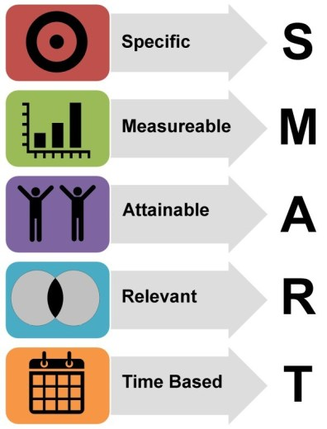
Goals/Objectives (What)
What will be achieved
By when
Need to be clearly stated
SMART
More is not necessarily better
Outcomes
This Photo by Unknown Author is licensed under CC BY-SA

Slide 25
Methodology & Design (How)
Clearly state how you intend on achieving your objectives (Outputs)
Be specific – but don’t use jargon
Who is doing what
When will it be done by
How will it be done
Include a timeline and process chart
Include research that supports your design

Slide 26
Evaluation
Plan for determining success of project
How will you know you have been successful?
Use both Quantitative and Qualitative measures
What will you measure (know it before you start)
How and when will you measure it
Who will measure

Slide 27
Sustainability
How will you continue the project once the grant has finished? Are you:
Creating products/publications
Building capacity
Training the trainer
Partnering with industry
Expanding membership
Charging a Fee for service

Slide 28
Budget
Use template if provided
Explain all Rev/Exp
Provide clarity in notes
Make sure it balances!
Match numbers throughout the application
Involve your Finance Office/bookkeeper

Slide 29
Revenues
Include all revenues both cash and in-kind
Be conservative
Don’t exceed limitations
Ensure Matching % are met
Use notes to describe confirmed/unconfirmed $$

Slide 30
Expenses
Determine all costs for the project including:
Administration
HR
Travel
Equipment
Materials
Operating costs
If this is a multi-year proposal, then each year needs to be budgeted

Slide 31
Conclusion
A brief summary of the problem and your solution
The request you are making for the grant
Why your organization is in best position to deliver

Slide 32
Appendices
Funder may provide a checklist. Key items include:
Research
Resumes of key personnel
Letters of Support
Registered Society info
Financial statements
Board of Directors directory

Slide 33
Do’s and Don’t’s

Slide 34
DO
Read grant guidelines carefully BEFORE starting
Contact a grant officer if you have any questions
Follow the instructions!
Develop a workback timeline from submission deadline
Use clear, concise and compelling language
Use statements you can back up with research/data/facts
Have someone proofread the final application

Slide 35
DON’T
Guess about something you are not clear about
Copy another organization’s grant
Use acronyms
Submit an application without letters of support
Submit your application after deadline
Compromise mission to secure funding
Give up – no just means no for now

Slide 36
Grant-writing & Job Hunting…

Slide 37
Review
How grant writing is like interviewing for a job…
Grant | Interview
Examine own funding history for positive partnership | Examine own experiences for concrete examples of experience
Research funder | Research employer
Use funders words in proposal | Use Employers words cover letter
Abstract/Proposal for screening | Cover Letter/Resume for screening

Slide 38
Review
How grant writing is like interviewing for a job…
Grant | Interview
Tailored proposals | Tailored resumes
Ask for feedback (proposal) | Ask for feedback (interview)
Don’t surprise your funder | Don’t surprise your boss
Build trust for long term funding relationship | Build trust for long term employment relationship

Slide 39
Quick Evaluation – 8 questions
Notes:
39

Slide 40
Any Questions or Comments?
Notes:
40

Slide 41
Upcoming Webinars
Conversation Matters
You can register on our website: www.sportlaw.ca/Webinar-Series

Slide 42
For more information: Robin Witty rlw@sportlaw.ca
www.sportlaw.ca

